Slide 1
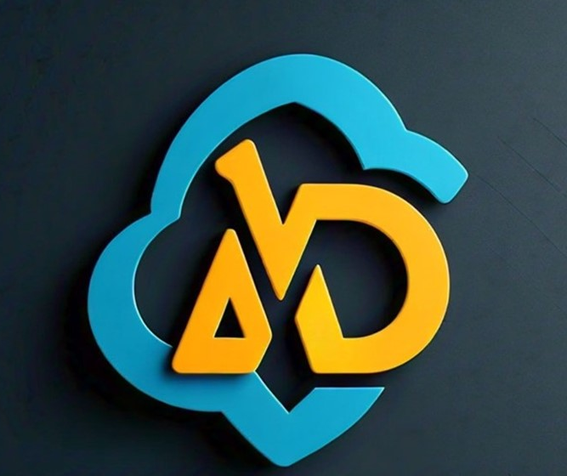
AWS Lambda
Rajender Thota

Slide 2
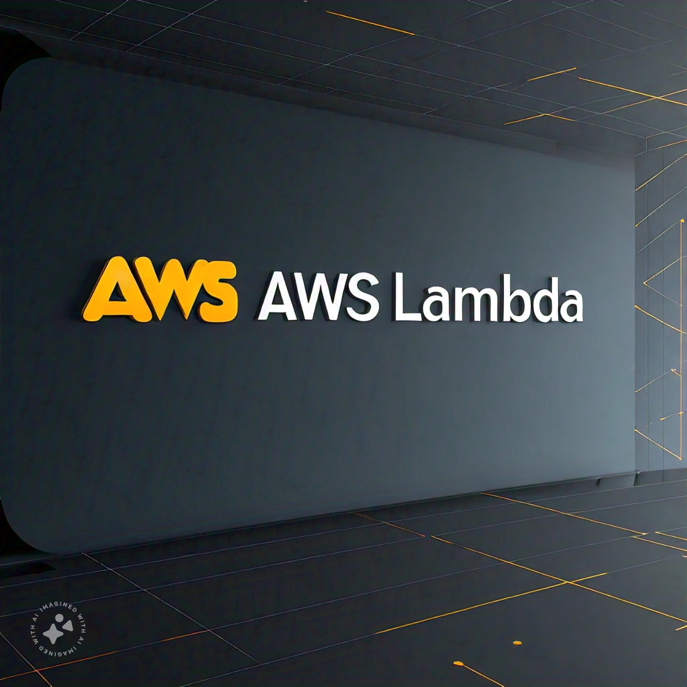
Agenda
What is AWS Lambda
Key Characteristics
How AWS Lambda Works
Supporting Triggers
Use Cases
Benefits
Live POC
QA

Slide 3

What is AWS Lambda
AWS Lambda is a serverless computing service provided by Amazon Web Services

Slide 4

Key Characteristics & Benefits
Notes:
Serverless architecture
Event-Driven Execution
Pay-as-You-Go Pricing

Slide 5

Serverless Architecture
AWS Lambda is a serverless computing service provided by Amazon Web Services
No Server Management: AWS Lambda handles the infrastructure, so you don't need to manage servers, scaling, patching, or administrative tasks
Automatic Scaling: Lambda automatically scales the number of function instances in response to the incoming event rate

Slide 6

Pay-as-You-Go Pricing
Cost-Efficiency: You pay only for the compute time you consume – there are no charges when your code is not running

Slide 7

Event-Driven Execution
Trigger-Based: Lambda functions are triggered by events such as changes in data state, updates to a database, file uploads, HTTP requests, or other triggers from AWS services or third-party applications
Notes:
Event-driven execution is a programming paradigm in which the flow of a program is determined by events or changes in state, rather than by a pre-defined sequence of steps.
In event-driven execution:
The program waits for events to occur (e.g., user input, network requests, sensor readings)
When an event occurs, the program executes a specific block of code (an "event handler") to respond to the event
The event handler may trigger additional events, leading to a cascade of event-driven execution
Event-driven execution is commonly used in:
GUI programming (e.g., responding to button clicks, mouse movements)
Web development (e.g., responding to HTTP requests, WebSocket messages)
IoT programming (e.g., responding to sensor readings, device connections)
Serverless computing (e.g., responding to cloud events, API calls)
Benefits of event-driven execution include:
Improved responsiveness and interactivity
Simplified code organization and reuse
Enhanced scalability and fault tolerance
Let me know if you'd like more information!

Slide 8

Automatic Scaling
Scales out automatically based on the number of incoming requests.

Slide 9
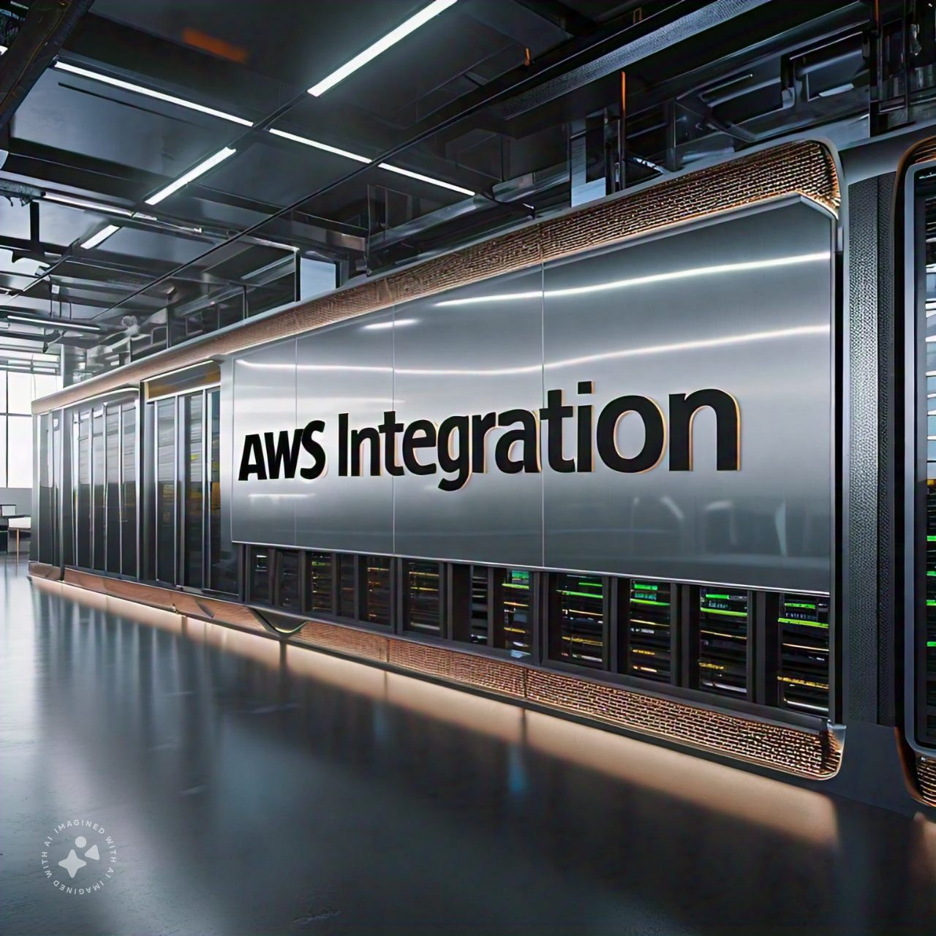
Integrations
Seamlessly integrates with other AWS services, making it a versatile component in cloud architectures.

Slide 10











Event-Driven Execution - Supporting Triggers
Event Source
Services
AWS Lambda
Amazon Kinesis Video Streams
S3 Bucket
Event Bridge
Endpoints
Trigger
Event (event-based)
API GATEWAY
S3 Bucket
Schedule Event (time-based)
Amazon Simple Queue Service (Amazon SQS)
Amazon CloudWatch
Data store

Slide 11
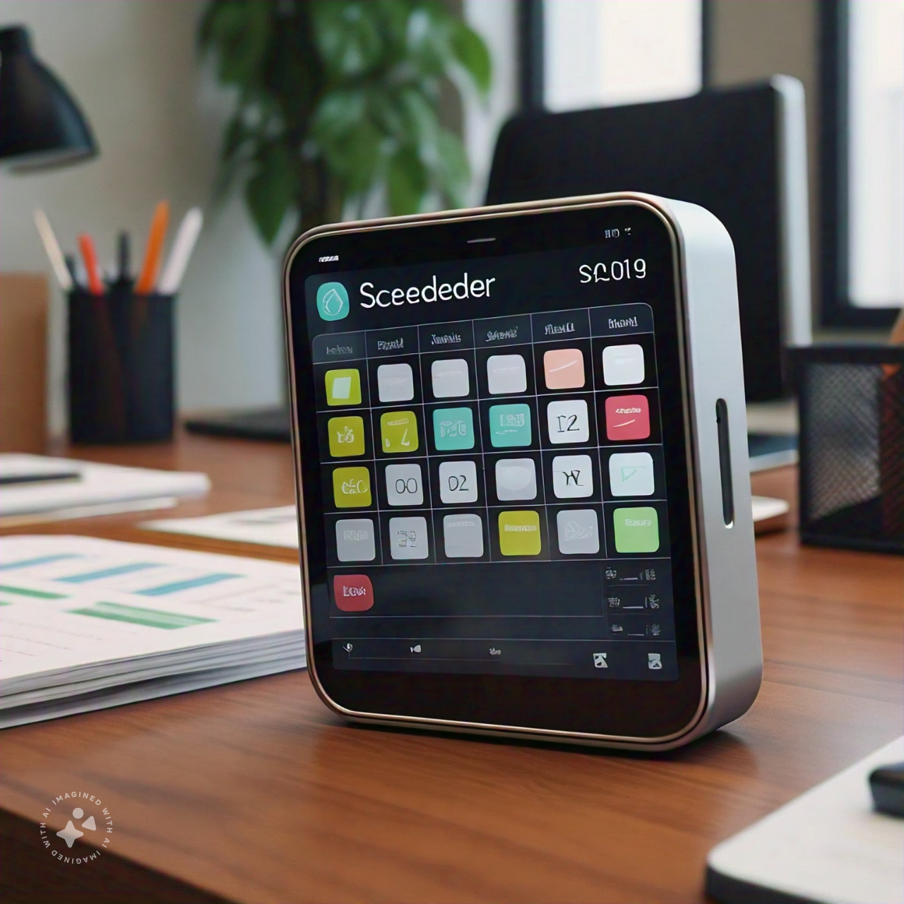
Supporting Triggers
AWS S3
AWS DynamoDB Streams
Amazon Kinesis Data Streams
Amazon SNS and SQS
Amazon API Gateway
AWS IoT Core
AWS CloudWatch Events
AWS CloudTrail Logs
Notes:
AWS S3: For object creation events (e.g., image uploads).
AWS DynamoDB Streams: For changes in a DynamoDB table.
Amazon Kinesis Data Streams: For processing real-time streaming data.
Amazon SNS and SQS: For handling messages.
Amazon API Gateway: For building APIs.
AWS IoT Core: For processing data from IoT devices.
AWS CloudWatch Events: For scheduled events (like cron jobs).
AWS CloudTrail Logs: For responding to changes in your AWS infrastructure.

Slide 12
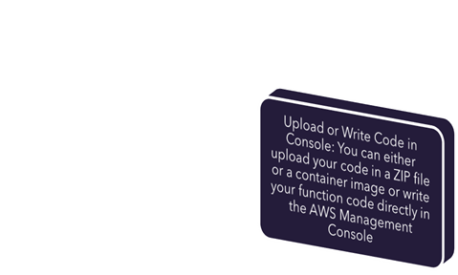
How AWS Lambda Works
Write Code: You write code in one of the supported languages
Upload or Write Code in Console: You can either upload your code in a ZIP file or a container image or write your function code directly in the AWS Management Console
Set Triggers: Configure AWS services or other event sources to trigger your Lambda function
AWS Lambda Execution: When the trigger condition is met, Lambda executes the function using the compute power and memory allocated

Slide 13

SAM
The AWS Serverless Application Model (AWS SAM) is an open-source framework for building serverless applications. It provides shorthand syntax to express functions, APIs, databases, and event source mappings. With just a few lines per resource, you can define the application you want and model it using YAML.

Slide 14

How AWS Lambda Works
Write Code: You write code in one of the supported languages
Upload or Write Code in Console: You can either upload your code in a ZIP file or a container image or write your function code directly in the AWS Management Console
Set Triggers: Configure AWS services or other event sources to trigger your Lambda function
AWS Lambda Execution: When the trigger condition is met, Lambda executes the function using the compute power and memory allocated

Slide 15
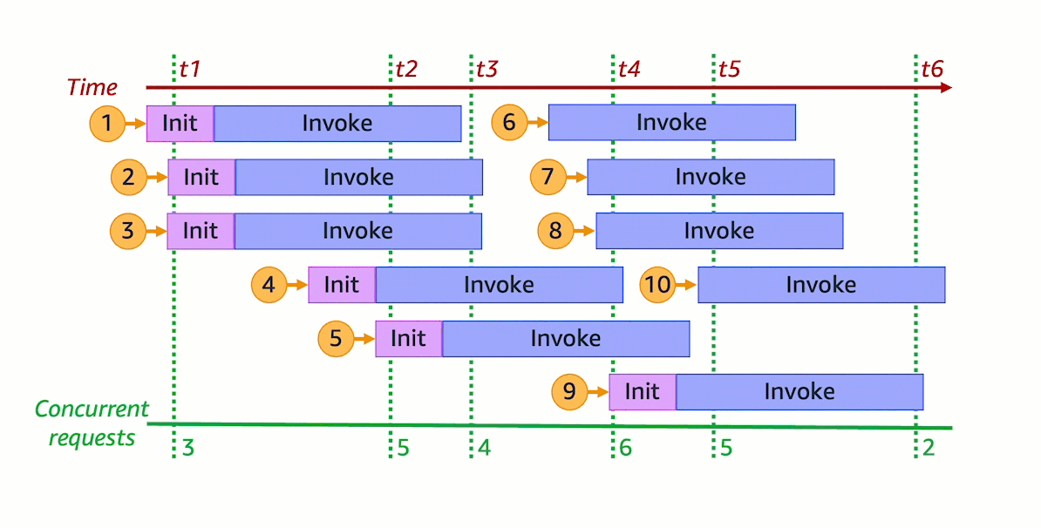
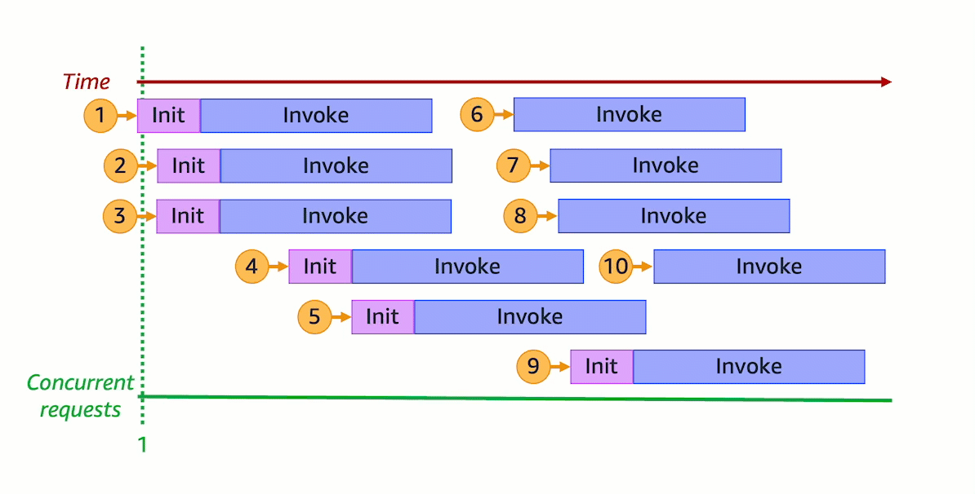
Lambda Concurrency
Notes:
https://docs.aws.amazon.com/lambda/latest/dg/lambda-concurrency.html
https://docs.aws.amazon.com/lambda/latest/dg/lambda-runtime-environment.html#runtimes-lifecycle-invoke
https://aws.amazon.com/lambda/faqs/

Slide 16
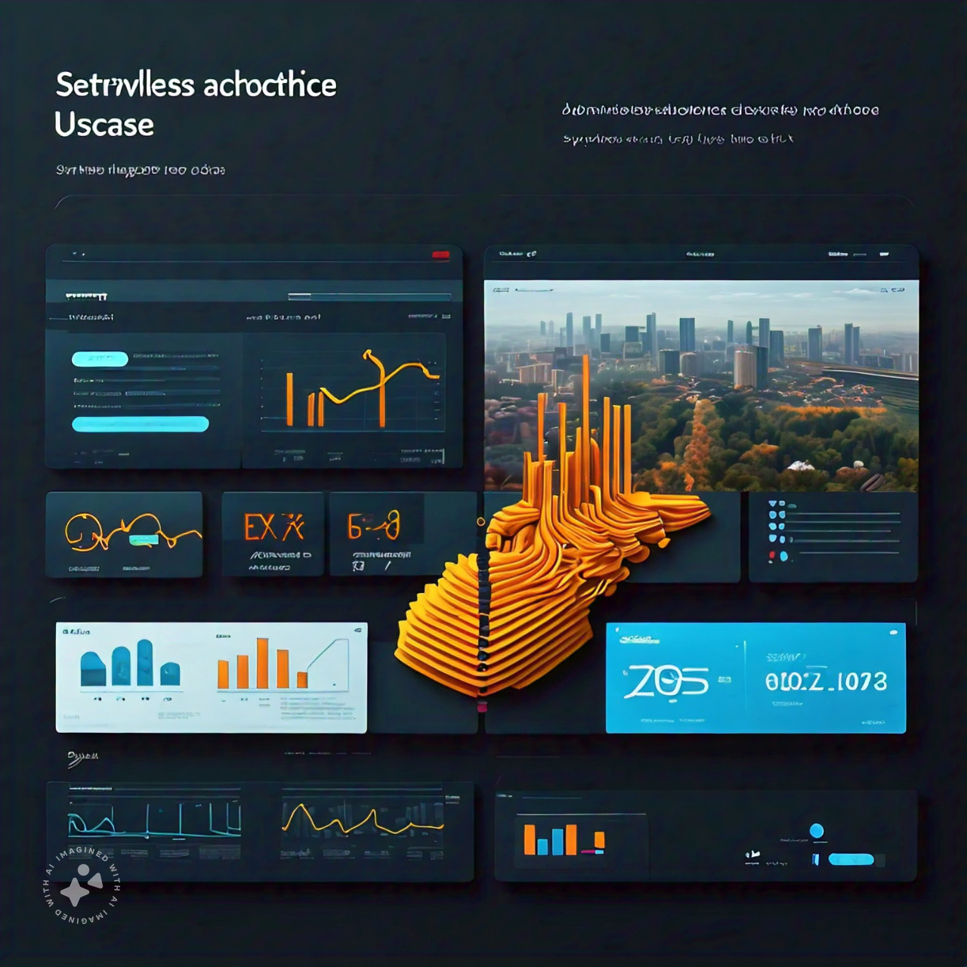
User Cases
Real-time File Processing
Data Transformation and ETL (Extract, Transform, Load)
Real-time Stream Processing
Microservices Backend
Chatbots and Voice Assistants
Scheduled Tasks (Cron Jobs) IoT Data Processing
Security and Compliance Automation
Notes:
1. Real-time File Processing
Example: Automatic resizing of images uploaded to Amazon S3, video transcoding, or extracting metadata.
How it works: Lambda functions can be triggered by S3 events (e.g., when a new file is uploaded).
2. Data Transformation and ETL (Extract, Transform, Load)
Example: Transforming data as it flows through a pipeline before storing it in a database or data warehouse.
How it works: Lambda can process data streams from Amazon Kinesis or DynamoDB Streams and then load the transformed data into another service.
3. Real-time Stream Processing
Example: Analyzing log data from AWS CloudTrail or processing clickstream data for analytics.
How it works: Lambda functions can process real-time data streams from Kinesis or Amazon MSK (Managed Streaming for Kafka).
4. Microservices Backend
Example: Implementing individual microservices functions such as user authentication, payment processing, or data retrieval.
How it works: AWS Lambda integrates with Amazon API Gateway to expose RESTful APIs that trigger Lambda functions.
5. Chatbots and Voice Assistants
Example: Building backend logic for chatbots on platforms like Amazon Alexa, Facebook Messenger, or Slack.
How it works: Lambda can handle requests from these platforms, process them, and return responses.
6. Scheduled Tasks (Cron Jobs)
Example: Periodically cleaning up a database, sending out daily reports, or syncing data between systems.
How it works: AWS Lambda functions can be scheduled using Amazon CloudWatch Events or EventBridge.
7. IoT Data Processing
Example: Processing data from IoT devices, filtering it, and storing it for further analysis.
How it works: Lambda can be triggered by AWS IoT Core when IoT devices send data.
8. Security and Compliance Automation
Example: Automatically responding to security incidents, managing IAM policies, or ensuring compliance with regulations.
How it works: Lambda functions can be triggered by AWS CloudTrail events, Config Rules, or GuardDuty findings.

Slide 17
User Cases
Real-time Notifications and Alerts
Backend for Mobile and Web Applications
Automated Backups and Snapshots
Dynamic Web Content Generation
A/B Testing and Feature Toggles
Serverless Machine Learning
Automated Software Deployment
Notes:
Real-time Notifications and Alerts
Example: Sending notifications when certain thresholds are met, such as high CPU usage or low inventory.
How it works: Lambda can send messages via Amazon SNS or SMS based on triggers from CloudWatch Alarms or other monitoring tools.
10. Backend for Mobile and Web Applications
Example: Handling user authentication, data validation, and backend logic for mobile apps.
How it works: AWS Lambda can be integrated with Amazon Cognito for user management and API Gateway for API endpoints.
11. Automated Backups and Snapshots
Example: Automatically creating backups of databases or snapshots of EC2 instances.
How it works: Lambda can be scheduled to run backup scripts and store backups in S3.
12. Dynamic Web Content Generation
Example: Generating web pages or content on-the-fly based on user inputs or data.
How it works: Lambda can be used with API Gateway to generate and serve dynamic content.
13. A/B Testing and Feature Toggles
Example: Rolling out new features to a subset of users and measuring performance.
How it works: Lambda functions can handle routing traffic and recording results for A/B tests.
14. Serverless Machine Learning
Example: Running inference on pre-trained models or processing data for training.
How it works: Lambda can be used to run lightweight ML tasks or integrate with services like Amazon SageMaker for more complex tasks.
15. Automated Software Deployment
Example: Orchestrating deployment pipelines, running tests, and deploying code to different environments.
How it works: Lambda can be part of CI/CD pipelines, working with AWS CodePipeline and CodeBuild.

Slide 18

Cron Job
0/15 22-23,0-10 ? * MON-FRI *
Notes:
0/15 22-23,0-10 ? * MON-FRI *
0/15: This means the task will run every 15 minutes, starting from the 0th minute (i.e., on the hour, quarter past, half past, and quarter to). The /15 specifies the interval.
22-23,0-10: This specifies the hours during which the task will run. It will run from 10 PM (22) to 11 PM (23) and then from midnight (0) to 10 AM (10).
?: This is a placeholder for the day of the month, which is not specified in this case. It means the task will run regardless of the day of the month.
*: This is a placeholder for the month, which is not specified in this case. It means the task will run regardless of the month.
MON-FRI: This specifies the days of the week during which the task will run. It will only run on Mondays, Tuesdays, Wednesdays, Thursdays, and Fridays.
In summary, this cron expression will run a task:
Every 15 minutes
Between 10 PM and 11 PM, and then from midnight to 10 AM
On weekdays (Monday to Friday)
Regardless of the day of the month or month
Let me know if you have any further questions!

Slide 19

Write Code: You write code in one of the supported languages
Upload or Write Code in Console: You can either upload your code in a ZIP file or a container image or write your function code directly in the AWS Management Console
Set Triggers: Configure AWS services or other event sources to trigger your Lambda function
AWS Lambda Execution: When the trigger condition is met, Lambda executes the function using the compute power and memory allocated
AWS Lambda is a serverless computing service provided by Amazon Web Services

